Slide 1
ETL For ODS

Slide 2
Objectives
Through this chapter you will be able
to understand:
What is an ODS?
What is data modelling
Real time ETL approaches?

Slide 3



ODS Overview
An operational data store ("ODS") is a database designed to integrate data from multiple sources for additional operations on the data. The data is then passed back to operational systems for further operations and to the data warehouse for reporting

Slide 4


ETL and ODS
ETL and ODS
What is a ETL?
ETL is data Extract, transformation and Loading associated
How ETL is used?
Data will be extracted from different sources
Sources will provide their own data in the format which can be processed
by ETL
The required functionalities will be covered in transformation phase to over shape the data
Finally it will be loaded into the tables as required

Slide 5
ETL and ODS
Operational Data Store is a repository between staging area and data warehouse
Data in ODS is at the level of low granularity.
Aggregated data would be loaded into EDW, once the data in ODS populated.
ODS is a semi DWH that helps the analysts to analyze business data
ODS also generates primary keys, handles errors and rejects similar to DWH

Slide 6
Data Modelling
Data Modelling
Data Model is a collection of conceptual tools for describing data, data relationships, data semantics and consistency constraint. A data model is a conceptual representation of data structures required for data base and is very powerful in expressing and communicating the business requirements

Slide 7


John
Anu
Data Model
Peter
Marry
Arun
Victor
Husband
Shalu
Peter
Marry
Mini
Wife
Father
Son
Mother-in-law
Daughter-in-law
How they are related with each other?
John
Anu
Wife
Son
Daughter
Son
Victor
Mini
Brother
Sister
Arun
Shalu

Slide 8
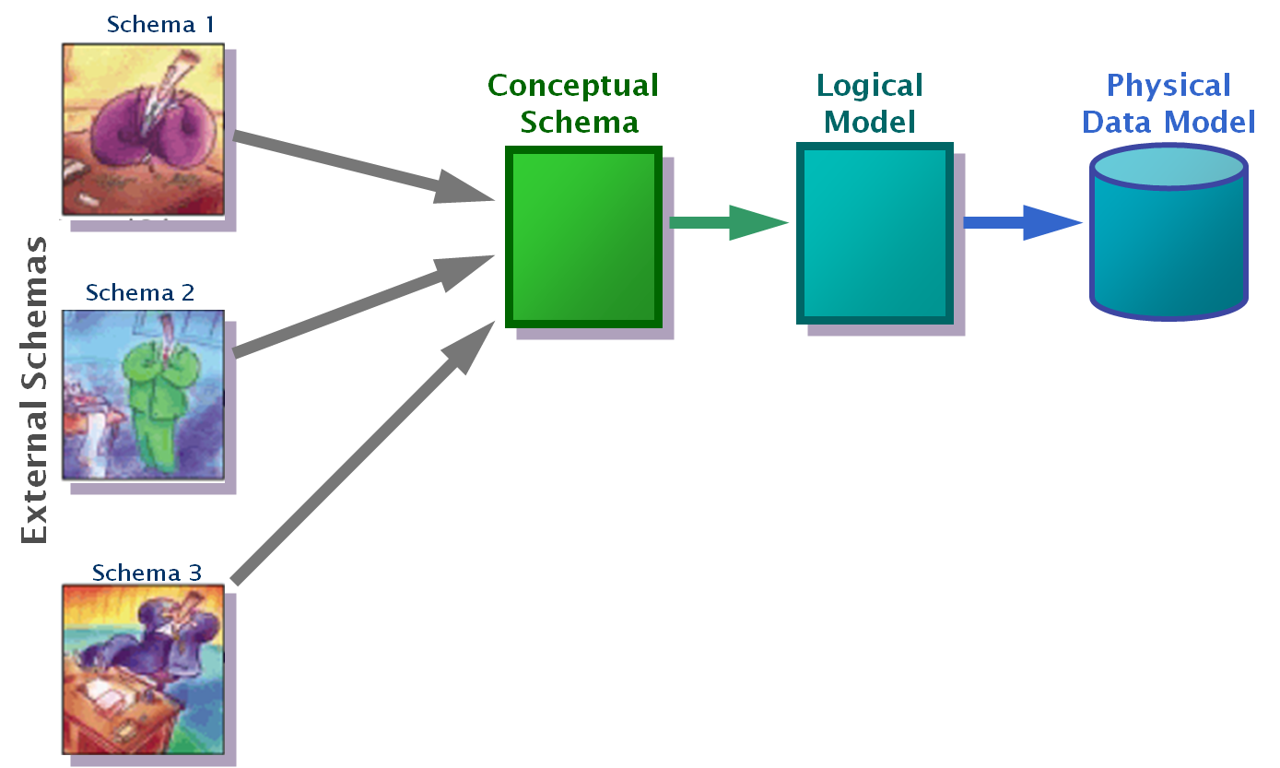
Data Model - Types
Conceptual: Describes WHAT the system contains
Logical: Describes HOW the system will be implemented, regardless of the DBMS
Physical: Describes HOW the system will be implemented using a specific DBMS

Slide 9
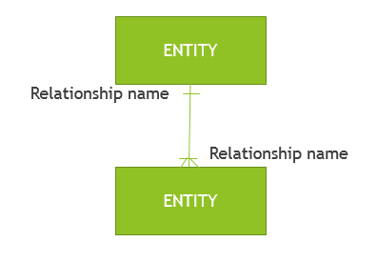
Data Model - Types (Cont..)
Data model element | Definition
Entity | A real world thing or an interaction between 2 or more real world things.
Attribute | The atomic pieces of information that we need to know about entities.
Relationship | How entities depend on each other in terms of why the entities depend on each other (the relationship) and what the relationship is (the cardinality of the relationship)

Slide 10
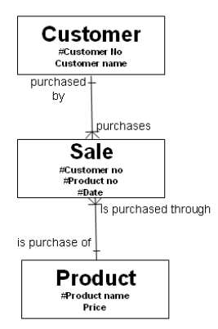
Example

Slide 11
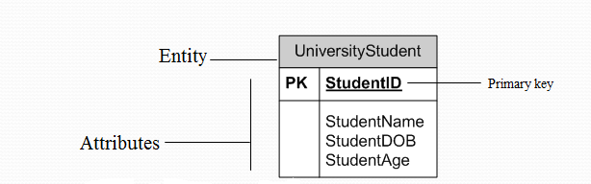
Data Model - ERD
Entity Relationship Diagrams (ERD) as this is the most widely used
ERDs have an advantage in that they are capable of being normalized

Slide 12
Data Model – ERD types
E-R modeling
Peter Chen
Information Engineering
Barkers Notation
IDEFIX
UML modeling
XML modeling
X- Entity modeling
XUML

Slide 13
Near/Real Time Approaches
What is Real-Time ETL?
Real-time ETL is a misnomer for a category of data warehousing services that is neither true real-time nor, in many cases, ETL. Instead, the term refers to software that moves data asynchronously into a data warehouse with some urgency—within minutes of the execution of the business transaction
Where/How to use that?
Real-Time approaches are mainly used to support the data which is keep changing everyday or everytime
Other reason is growth in the data volume

Slide 14

Real Time Approaches
Can I implement real-time always?
Delivering real-time data warehousing demands an approach quite different from the ETL methods used in batch-oriented data warehousing.
Simply running conventional ETL batches on an ever-more frequent schedule throughout the day might not be practical, either to the OLTP systems or to the data warehouse.
Hence different approaches can be followed for real time

Slide 15
Real Time Approaches
Microbatch ETL
Conventional ETL, the file-based approach is extremely effective in addressing daily, weekly, and monthly batch-reporting requirements. New or changed transactions (fact records) are moved en masse, and dimensions are captured as point-in-time snapshots for each load. Thus, changes to dimensions that occur between batch processes are not available in the warehouse
Conventional ETL:
It is a simple, direct, and tried-and-true method for organizations that have more casual latency requirements and complex integration challenges

Slide 16
Real Time approaches – Conventional ETL
Conventional ELT Diagram
Logical Data Warehouse
OLTP Application A
Change Detection / Snapshot
Batch
Batch
Data Mart A
OLTP
ELT
OLTP
Database A
OLTP Application B
Change Detection / Snapshot
Batch
Batch
Data Mart B
OLTP
OLTP
Database B
Dimension Authority

Slide 17
Real Time approaches - Challenges
Number of unique challenges :
System-availability requirements – as the business comes to rely on low-latency availability of business transactions in the data warehouse.
The posture of the data warehouse as system of discrete periodic
Continuous temporal information.
Example: The frequency of fact loading increases from once per day to every 15 minutes, but more dramatically if the loading of facts and dimension records occurs continuously. The data warehouse might then capture a record of the business transactions and their dimensional context at all points in time. Slowly changing dimensions become rapidly changing dimensions.

Slide 18

Test your Understanding
Explain how ODS and ETL are interrelated
Explain the need of data modelling
Explain types of data modelling techniques.
Explain the need for real time ETL and challenges

Slide 19
Summary
ODS is data integration from different data source and provide the end user requested data by multiple operations
A data model visually represents the nature of data, business rules governing the data, and how it will be organized in the database
ERD approach for data modelling
Conventional ETL for real time approach implementation

